Slide 1

Chapter 11
Perspective Taking: Gratitude and Forgiveness

Slide 2
Gratitude & Forgiveness as Perspective Taking
Gratitude: acknowledging contributions of others in making life better
Forgiveness: process of letting go of negative emotions when hurt or transgressed against
Both require taking the other person’s perspective

Slide 3

Why does perspective taking matter?
Makes the world a smaller place
  Access lessons through the experience of others
  Highlights shared experiences
Builds, nurtures, and maintains relationships
Gratitude and forgiveness related to psychological health
  Particularly eudaimonic well-being
  Purpose and meaning

Slide 4
Gratitude
Trait – tendency to easily experience appreciation, be aware of life’s abundance, and acknowledge the good in one’s life across circumstances
State – emotional experience of grateful, appreciative, or thankful in a moment
More gratitude is associated with:
  Lower loneliness, perceived stress, symptoms of depression
  Higher subjective health, self-esteem, and positive affect

Slide 5
Cognitive Model in Action: Gratitude & Sleep
In a sample of 401 adults from the community:
  Higher self-reported gratitude associated with more hours of sleep, better sleep, less daytime sleepiness, and less time to fall asleep
  These relationships were explained by pre-sleep cognitions
  Gratitude → more positive thoughts at bedtime → better sleep

Slide 6
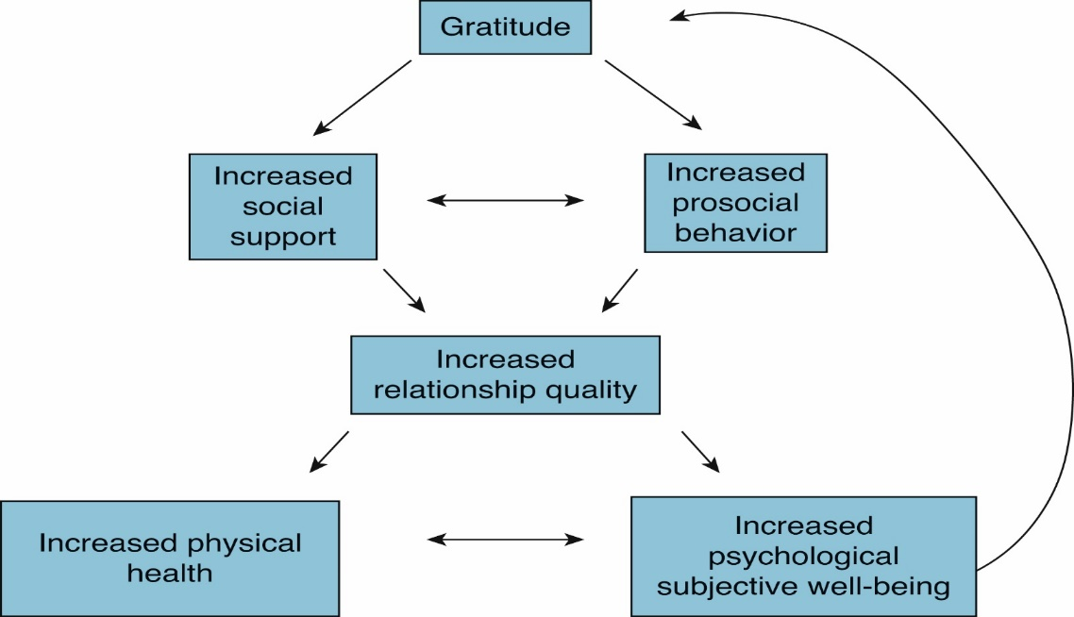
Psychosocial Model of Gratitude (Alkozei et al., 2018)
Notes:
Grateful people more likely to make positive interpretations of situations and more likely to remember events more positively.

Slide 7
Gratitude and Social Relationships
Study: Sorority Big and Little sisters
  Little sisters completed on-line questionnaire after each receipt of a reveal week gift
  Perceived responsiveness, surprisingness, and liking predicted gratitude for event
  Cost and perceived effort predicted gratitude
  Gratitude predicted feelings of closeness and integration into sorority one month later
  The gratitude reported by the “Little” before reveal predicted “Big” rating of relationship and time spent together one month later

Slide 8
Circumstances that Facilitate or Suppress Gratitude
Individual Differences
Estimates suggest that approximately 40% of the tendency to experience gratitude is inherited (Steger et al., 2007)
May be particularly related to oxytocin and CD38 (a gene related to secretion and regulation of oxytocin; Algoe & Way, 2014)
Environmental Differences
Perception that you have benefitted from something you can’t control (Rusk et al., 2016)
Perception that the beneficial circumstance was surprising (Koo et al., 2008)
Perception that action was responsive to wants or needs (Algoe et al. 2008)

Slide 9
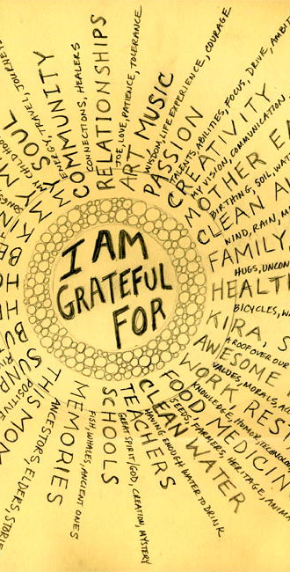
Gratitude
Grateful people tend to be happy people
Gratitude can maintain and enhance personal relationships
Gratitude related to greater life satisfaction, optimism, and more positive and less negative emotionality
Gratefulness related to wanting to give back to others…can expand outward and benefit the world

Slide 10

Gratitude
Gratitude can be nurtured through practice
  Gratitude letter
  Gratitude journal

Slide 11

Gratitude Interventions
Three Good Things
  Write down three good things that happen every day
  Compared to placebo, increases in happiness 1, 3, and 6 months after intervention (Seligman et al., 2005)
Gratitude Letter/Visit
  Identify someone to whom you haven’t yet adequately expressed your gratitude
  Write letter with specific details
  Option to visit and read them the letter
  Compared to placebo, large increases in happiness that lasted one month (Seligman et al, 2005)

Slide 12

Gratitude (Soul Pancake)

Slide 13
Journal Entry #20 Gratitude Letter
Start with a warm salutation
Summarize why you’re grateful for your recipient
Mention specific details about the recipient and their impact of the things they did for you
Focus on the recipient
Be specific
Conclude with an expression of gratitude

Slide 14
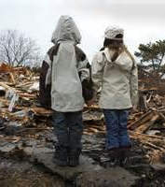
Gratitude
Gratitude can also come from non-human actions or events
  e.g., surviving a natural disaster

Slide 15
Forgiveness

Slide 16
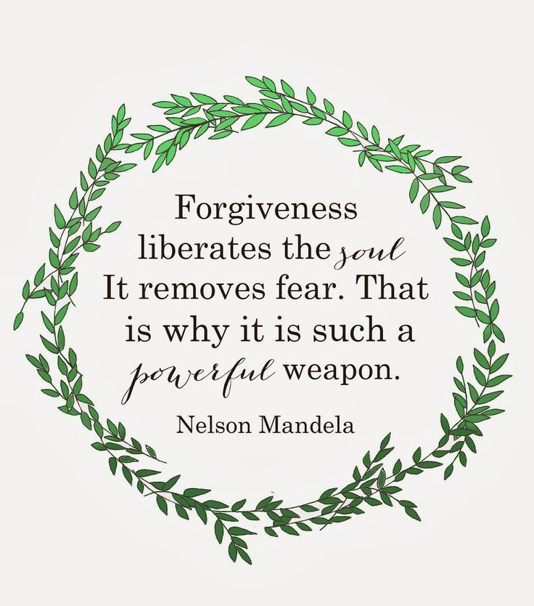
Forgiveness
Many definitions: consensus is that forgiveness is beneficial
Without forgiveness, anger and resentment take over and can be a cycle of hostility and desire for revenge
Research scenarios: Women more likely to forgive than men, children less willing to forgive than adult, older adults more likely “let bygones be bygones”

Slide 17
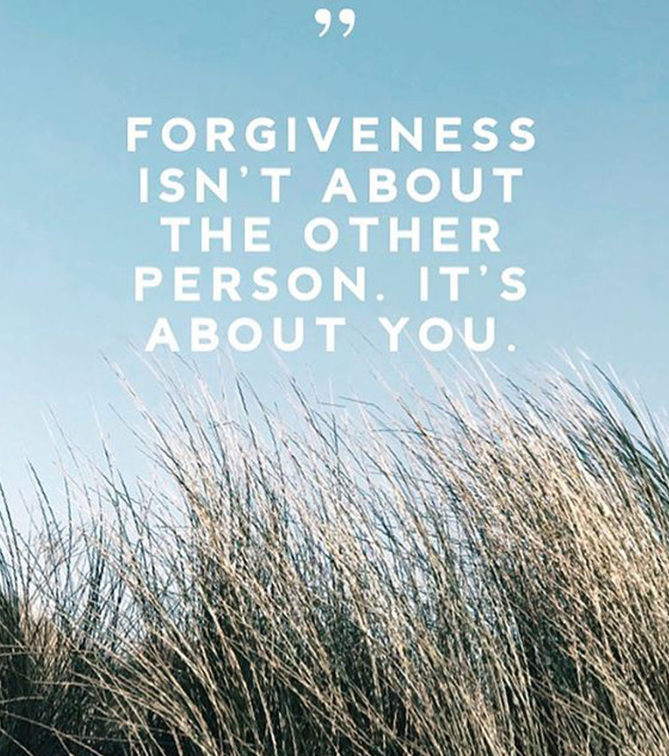
Forgiveness
Aspects of Forgiveness
  Cognitive (changing negative judgments)
  Emotional (overcoming resentment)
  Behavioral (ending indifference)
Forgiveness means overcoming the hurt, resentment, and aggression that accompany being the target of mistreatment

Slide 18

Forgiveness
Forgiveness is NOT:
  Simply tolerating or forgetting an injustice
  Using denial or suppression
  Forgetting, denying, or minimizing the hurt
  Condoning what was done
Allows us to move on from transgressions
Forgiveness promotes well-being
Should enhance shared humanity and may deepen a connection with others and increase one’s compassion

Slide 19
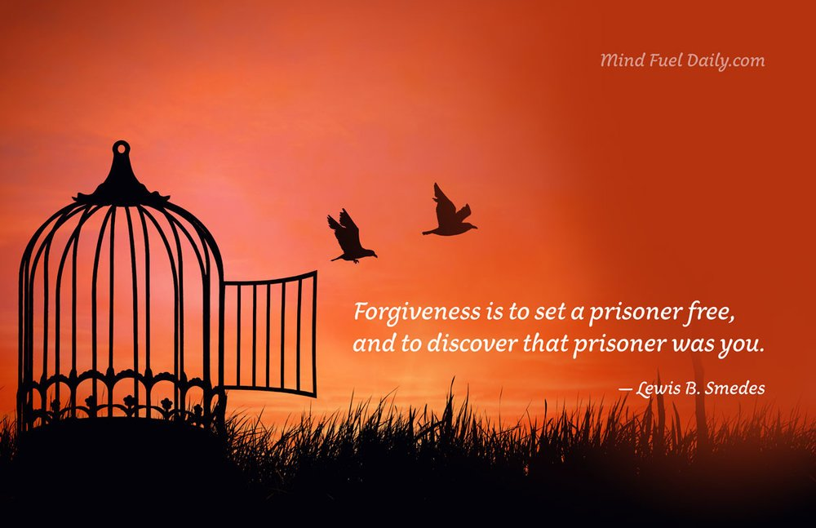
Forgiveness
Phases of Forgiveness
Uncovering phase
Decision phase
Work phase
Deepening phase
Notes:
Uncovering phase: Explore how resentment and anger are destructive.
Decision phase: Making choice to forgive.
Work phase: Tries to find understanding of why offender did so.
Deepening phase: Gain deeper sense of meaning as result of injury.

Slide 20
Forgiveness: Phases
Uncovering phase
  How resentment, anger, hurt is exerting destructive impact on life
Decision phase
  Making a choice to try to forgive
Work phase
  Reframe incident, accept hurt, try to find empathic understanding for why offender did what they did
Deepening phase
  Try to gain deeper sense of meaning
Notes:
Uncovering phase: Explore how resentment and anger are destructive.
Decision phase: Making choice to forgive.
Work phase: Tries to find understanding of why offender did so.
Deepening phase: Gain deeper sense of meaning as result of injury.

Slide 21

Forgiveness
Cognitive-Affective Transformation
(Tangney and Colleagues)
Freely choosing to “cancel the debt”& give up the need for revenge
Giving up negative emotions is key
Removing self from the victim role

Slide 22
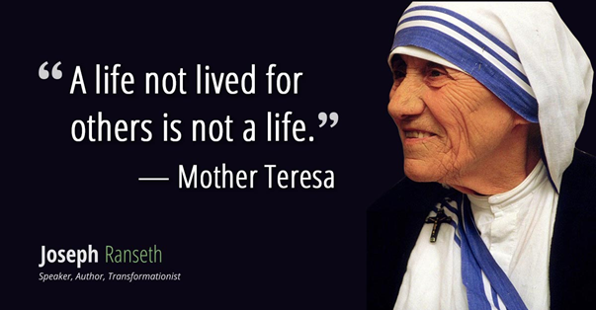

Slide 23
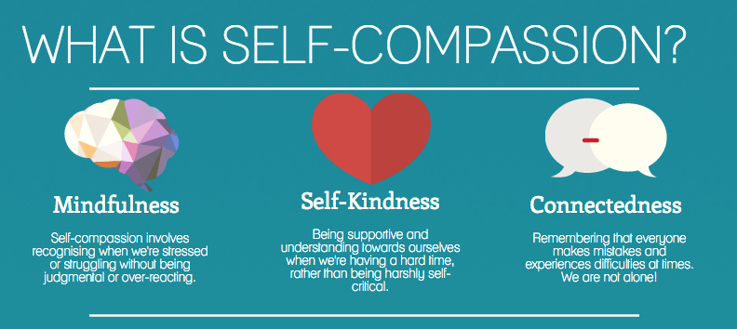
The Sacred Emotions
Self-compassion
Being kind toward oneself is better way to change behavior
Self-compassion makes us happier, optimistic, wiser
Self-compassion adults had greater motivation for self-improvement

Slide 24
What Forgiveness Is and Is Not
Forgiveness is: The process of reducing negative emotions, thoughts, and motivations toward another person who has wronged you
Forgiveness is not: Excusing, pardoning, condoning, forgetting
Forgiveness does not require continued relationship with transgressor
Forgiveness does not require communicating forgiveness to transgressor
Forgiveness is associated with psychological and physical health and better relationships

Slide 25
Forgiveness Interventions
Enright et al. (1996)
  Recognize and express negative emotions, including anger
  Consider what it would mean to find and grant forgiveness
  Commit to forgiveness, generating empathy and understanding for the offender
  Attempt to find meaning in the pain you’ve experienced

Slide 26
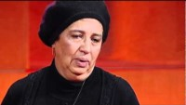
The Mothers Who Found Forgiveness

